Slide 1
Monitoring Ovulation Induction Cycle
SIG Endocrinology 2019
Chairperson – Madhuri Patil

Slide 2
Why Monitor OI cycles?
Patient’s initial parameters
Base Line scan TRO
Ovarian or Uterine pathology
AFC
Base line hormonal profile ovarian reserve
FSH:LH ratio
androgen excess
thyroid profile/ hyperprolactenemia
Ovarian response to OI
Confirmation of down regulation after GnRH agonist
Determine response to drug
Determine the dose & length of GT TX
Determine optimal time for hCG administration
Detect ovulation
Completion of therapy
Diagnose complications of OI
1. Premature lutenisation
2. Endogenous LH surge
3. Retention / Functional cyst
4. Persistent CL
5.Ovarian torsion
Confirm pregnancy
Choose appropriate stimulation regimen to prevent
OHSS/Multiple pregnancy
Predict response to ovarian stimulation
Time OR
Identify poor responders
women at risk of OHSS
TRO multiple pregnancy
TRO Late onset OHSS
Diagnose Ectopic Pregnancy

Slide 3
MONITORING
Hormonal Evaluation
Ultrasound
Follicular size
Absence of ovarian cyst
Endometrial thickness
Timing of ovulation
Ovarian Morphology / Reserve / Blood flow
FSH
LH
E2
P4
Beta hCG

Slide 4
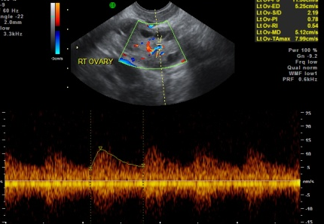
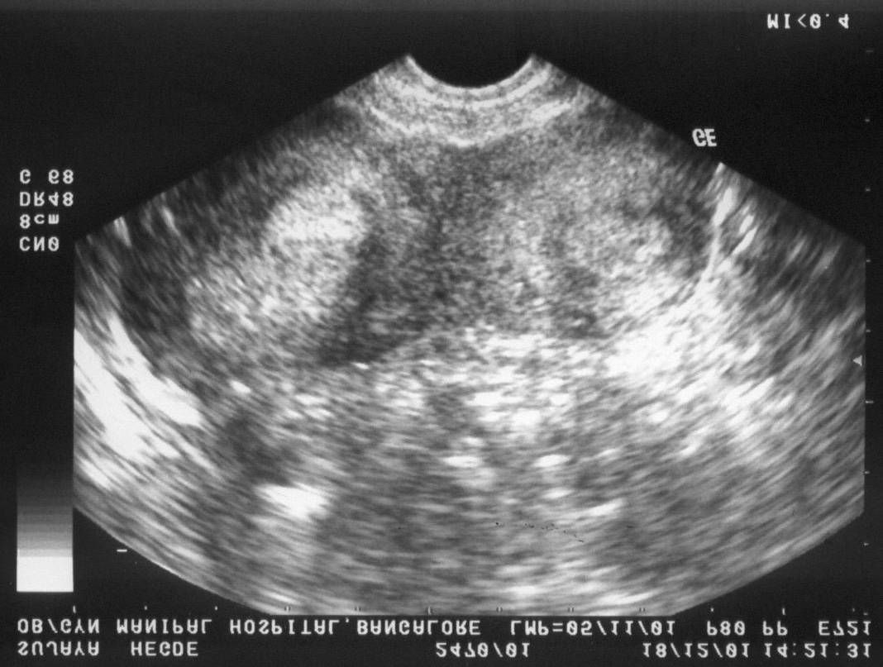
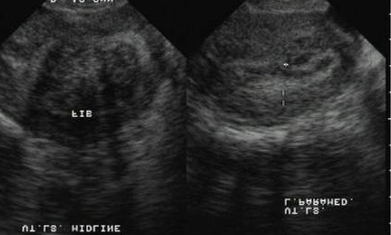
Baseline scan on Day 2 – 3 of MC
To identify morphology of ovary and adenexal abnormalities – ovarian cyst, hydrosalpinx
To assess the ovarian reserve
To identify uterine abnormalities – myoma, adenomyosis, polyps, intrauterine adhesions, endometrial abnormalities, congenital anomalies
To decide the stimulation protocol for adequate response

Slide 5
OI initiated on Day 2/3
Follicular size is < 10 mm
Absence of ovarian cyst
Endometrial thickness < 6 mm
E2 levels < 50 pg/ml and P4 < 1.5 ng/ml
Adjustment of GT dose – Serial USG and Log increment in E2

Slide 6
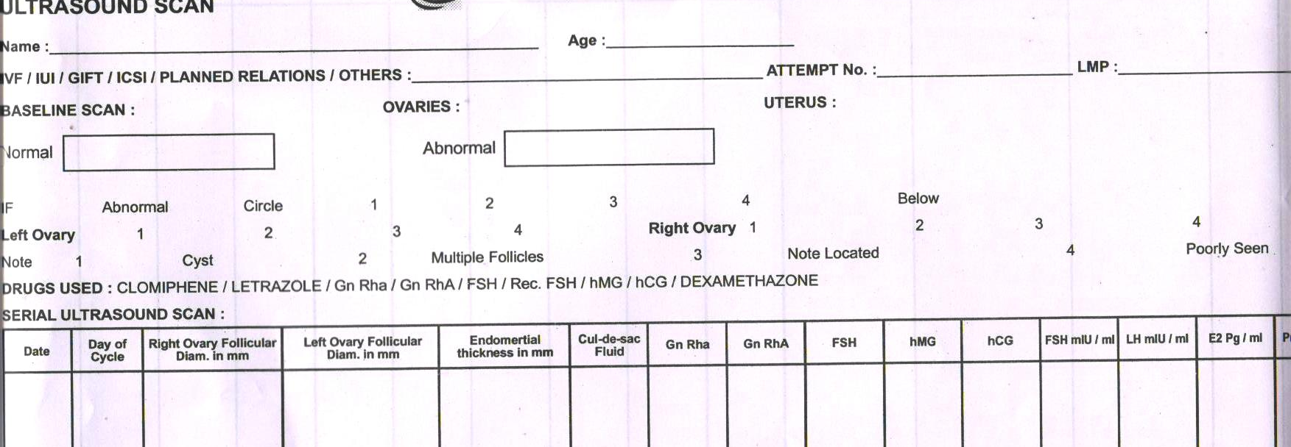
Follicular Tracking Record
Follicular growth recorded on specially designed charts that allow us to see at a glance all the relevant characteristics of the cycle
1. Date and Day of cycle 2. Number of developing follicles in each ovary
3.Dynamics of follicular growth 4.Endometrial thickness
5.Type of ovulation regimen & dose 6. Hormonal Profile

Slide 7
Follicular Tracking in Natural cycle
Antral follicles visible 10 days before ovulation
Dominant follicle visualized 5 days before ovulation
Dominant follicle grows at rate of 2-3 mm per day
Ovulation occurs at a follicular diameter of 20 – 27 mm
Other follicles undergo atresia or developmental arrest
Normal Follicular growth correlates with E2 measurements
Mature follicle secrets 250 – 300 pg/ml of E2
Follicular size more accurate than E2 in predicting ovulation

Slide 8
Follicular Tracking in Ovulation Induction cycles Timed Intercourse/Intrauterine Insemination
CC/Tamoxifen cycles
Base line scan on Day 2 or 3
Subsequent scan - 8 days later
Determines timing of next scan
If dominant follicle > 14 mm within 24 hours
Rate of growth 2 – 4 mm/day
Administration of hCG when dominant Follicle 20 mm
GT Cycles
Base line scan on Day 2 or 3
Subsequent scan - 4 days later Determines response
Next – 2 days later
Determines timing of subsequent scan and GT dose
Administration of hCG when dominant follicle 18 -20 mm

Slide 9
Sudden collapse of growing follicle
Central echoes within the follicle
Crenation of the follicular wall
Decreased follicular size
Appearance of follicular fluid in cul-de-sac
Formation of CL – internal follicular area becomes isoechogenic with respect to surrounding ovary
Sonographic indicators of Ovulation
RI 0.35 - 0.50
PI 0.70 - 0.80
PSV 10 - 15
Free Fluid

Slide 10
Follicular growth in Ovulation Induction cycles
ART – GT + GnRh agonist or antagonist
Base line scan on Day 2 or 3
Subsequent scan - 4 days later - Determines response
Next – 2 days later – Determines timing of subsequent scan & GT dose / administration of antagonist
At each scan the size of all follicles documented
Daily scans once follicular diameter 12 mm or >
Administration of hCG - > 3 dominant Follicle 16 - 18 mm
OR 35-36 hours later

Slide 11
Monitoring endometrial changes when tracking follicular growth
Endometrial thickness - a reliable bioassay of the patient’s estrogenic status
Changes correlate with plasma E2 & P4 levels
Early proliferative phase – translucent and thin on either side of midline echo
Late proliferative phase – increase in thickness with hypo-reflective area in the center
Following ovulation – shrinks in thickness, becomes dense echogenic on either side of midline echo

Slide 12
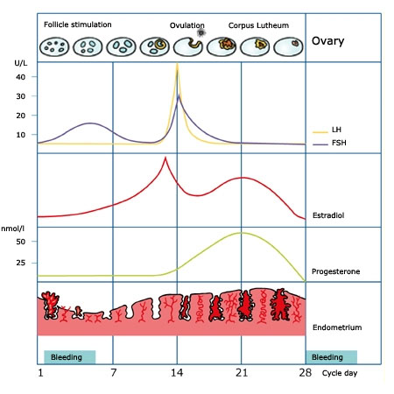
Hormonal Monitoring
Fertility is associated with marked daily changes in hormone output
Any pattern that shows no changes from day to day denotes infertility
LH surge likely to occur only when the serum E2 level has reached 164 pg/ml

Slide 13
Hormonal Monitoring
Without use of GT and GnRH analogues
E2 levels - occasionally depending on response 1. Endometrial thickness 2. Number and size of follicles
With use of GT and GnRH analogues
E2
LH
Monitored more often

Slide 14
Hormonal Monitoring
Stimulated cycle
Baseline E2 , 50 pg/ml and P4 , 1 ng/ml to initiate ovarian stimulation
Day 4 E2 – to know time for initiation of antagonist
On day of ovulation trigger
E2 – to predict response
P4 to know if late follicular elevation present
Natural cycle
Blood levels
Urinary LH kit
Only FET cycles
LH once follicle 16 – 17mm to determine LH surge to time the FET
E2 levels may be done between day 4 to day of ovulation trigger in presence of poor or hyper response to determine neccesity to increase or decrease gonadotropin dose

Slide 15
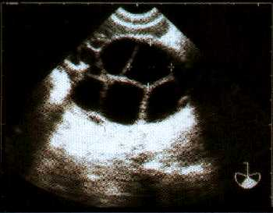
Adjustment of GT dose
Depends on
Serial E2
Serial USG
Initial dose changed after 4-5 days
Day 4 of OI if number of follicles
<4 or rise in E2 <50% dose by 37.5/75 IU >8 or rise in E2 >100% dose by 37.5/75 IU
Day 7 of OI if rate of growth
< 2 - 3 mm/day and < 4 follicles, < 12 mm or rise in
E2 < 50 % dose by 37.5/75 IU
Day 7 of OI if rate of growth > 2-3 mm /day and number of follicles > 10, > 12 mm or E2 rise > 100 % dose by 37.5/75 IU
Continue same dose if follicular growth 2-3 mm/day and rise in E2 between 50 – 100 %
Thereafter the dose increased or decreased depending on rate of growth and number of dominant follicles along with E2 levels

Slide 16
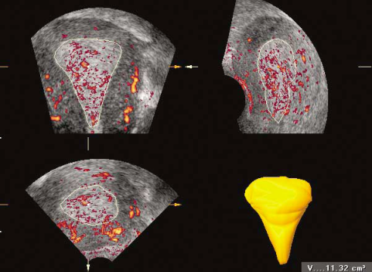
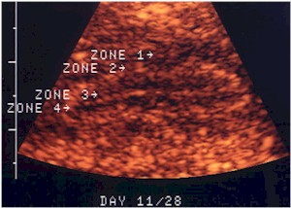
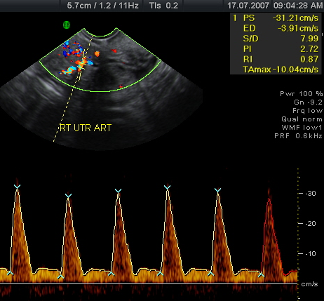
What ultrasound parameters indicate a GOOD receptive endometrium ?
Endometrial morphology – “triple
line” pattern
Endometrial thickness of 8–14 mm
Endometrial perfusion – presence of subendometrial & endometrial flow
Higher Subendometrial VI, FI & VFI on Day of hCG in conception group
Uterine Vascularity – Mean uterine artery PI between 2 – 3 and uterine artery PSV - 15 -20 cm/s
Volume of > 2ml has a significantly higher PRs
Persisting presence of FC waves until hCG administration Later the wave direction switch occurs from FC to CF, the hig (Marga M et al )
her the likelihood of pregnancy

Slide 17
Endometrial fluid before embryo transfer in IVF cycles is associated with poor prognosis
Cervical mucus that ascends into the endometrial cavity
Fluid reflux from a hydrosalpinx
Subclinical uterine infection
Abnormal endometrial development
Presence of persistent fluid accumulation -
freeze all embryos and postpone ET

Slide 18
Cancellation of ovarian stimulation cycles
Definite Indication
Poor follicular growth
E2 levels < 100 pg/ml on day 5 – 6
Possible Indication
Adnexal cyst secondary to GnRH agonist
Endogenous LH surge
Steady decline in E2 levels

Slide 19
USG also useful in monitoring abnormal response to Ovulation Induction
Premature lutenisation
Endogenous LH surge
Poor response
Hyperstimulation
Retention/Functional cyst
Ovarian torsion

Slide 20
Monitoring helps the physician to choose the most suitable protocol, to obtain best possible outcome avoiding complications
Induction of ovulation and IVF protocols can be monitored successfully by measuring endometrial thickness and size of ovarian follicles
USG monitoring of follicular growth - most important tool in assessment of progress in ovarian stimulation
Improves chance of safe & effective treatment with OI
USG also allows diagnosis of disorders and complications of ovulation
Monitoring luteal phase helps confirm ovulation and pregnancy by beta hCG and USG documentation of pregnancy (20 days post ovulation when beta hCG is 1000 mIU/ml),
Base line USG provides information on ovarian morphology and allows to choose appropriate stimulation regimen to prevent OHSS & MPR
Take Home Message
Baseline scan also predicts patients response to ovarian stimulation

